Slide 1
Safe Beginnings
Burn Prevention

Slide 2
Safe Beginnings is brought to you by:
Innovative Partnerships Program: Sierra-Sacramento Region
A 14-County Collaborative of Child Abuse Prevention Councils
In Partnership with:
The Office of Child Abuse Prevention
The Child Abuse Prevention Council of Sacramento
Funded, in part, by California Department of Public Health Kids’ Plates Program

Slide 3
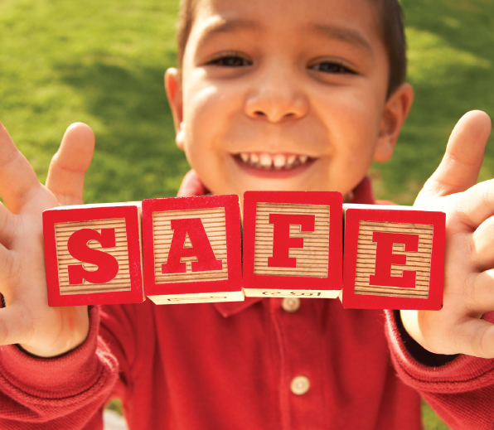
Purpose: How to Keep your Child Safe from Burns
We are going to talk about:
Child Burn Injuries in California
Types of Burns
Causes of Burns
When your Child is Burned
Notes:
The purpose of this training is to provide information, tools, and resources to parents and caregivers of children age 0 to 5 that maximize safety and prevent unintentional injuries. By the end of this training, the participant will be informed as to how to prevent unintentional burn injuries.
Photo taken from:
https://www.kidcheck.com/blog/kidcheck-shares-safety-tips-vbs/

Slide 4
Unintentional Child Burn Injuries in California
Non-Fatal Burn Injury Hospitalization in California, 2015
AGE GROUP | TOTAL
<1 | 98
1-4 | 383
5-9 | 105
10-14 | 76
15-19 | 102
Source: http://epicenter.cdph.ca.gov/ReportMenus/CallReportingServicesDataSummaries.ashx?reportID=11&reportDataID=2&DataYear=2015&countyList=101&OutputFormat=1
Notes:
Data in table taken from:
California data from the California Department of Public Health EpiCenter
http://epicenter.cdph.ca.gov/ReportMenus/CallReportingServicesDataSummaries.ashx?reportID=11&reportDataID=2&DataYear=2015&countyList=101&OutputFormat=1
*CDPH separates burn injury type into two categories: Fire/Flame and Hot Object/Substance
-The table above combines the totals from both categories

Slide 5
Child Burn Injuries in [Your County]
Include any county-specific data here.
Check these sources to find data for your county
http://epicenter.cdph.ca.gov/
https://www.kidsdata.org/
Sources:

Slide 6
Types of Burns
First-degree burns cause damage to the outer later of the skin
Second-degree burns damage the outer layer as well as the layer underneath
Third-degree burns damage or destroy the deepest layer of skin and tissues underneath
Source: https://medlineplus.gov/burns.html
Notes:
Information taken from:
https://medlineplus.gov/burns.html
Infographic taken from:
https://twitter.com/safekids/status/1190274679002533888

Slide 7
Common Causes of Burns of Infants and Children
Bathtub Scald
Kitchen Burns
Sunburn
Touching or Falling on Hot Appliances
Electrical Cords and Outlets
Eating or Drinking Chemicals & Button Batteries
Flames and Sparks

Slide 8
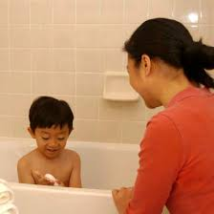
Bathtub Scald: Prevention
It only takes 3 seconds of exposure to 140º F water to cause a burn severe enough to require surgery
Set the thermostat on your hot water heater to 120º F
Test bath water with your wrist or elbow (water should feel warm, not hot)
100º F is a safe bathing temperature
Place your toddler at the end of the tub to keep them from playing with the faucet
Sources:
http://ameriburn.org/wp-content/uploads/2018/12/nbaw2019_statsdataresources_120618-1.pdf
https://www.stanfordchildrens.org/en/topic/default?id=facts-about-burn-injury-90-P02796
https://www.mayoclinic.org/healthy-lifestyle/infant-and-toddler-health/in-depth/child-safety/art-20044027
https://www.nationwidechildrens.org/family-resources-education/health-wellness-and-safety-resources/helping-hands/burn-prevention-infant-and-toddler
https://www.safekids.org/safetytips/field_risks/burns-and-scalds
Notes:
-Hot water need not be at boiling point to burn skin
-It only takes 3 seconds of exposure to 140º F water to cause a burn severe enough to require surgery
-Children age 3 and younger account for the greatest number of pediatric burn patients for scalding liquid injuries
-Always provide supervision when your child is in the bathtub
Information taken from:
http://ameriburn.org/wp-content/uploads/2018/12/nbaw2019_statsdataresources_120618-1.pdf
https://www.stanfordchildrens.org/en/topic/default?id=facts-about-burn-injury-90-P02796
https://www.mayoclinic.org/healthy-lifestyle/infant-and-toddler-health/in-depth/child-safety/art-20044027
https://www.nationwidechildrens.org/family-resources-education/health-wellness-and-safety-resources/helping-hands/burn-prevention-infant-and-toddler
https://www.safekids.org/safetytips/field_risks/burns-and-scalds
Image taken from:
http://www.findglocal.com/US/Southfield/1965871263724831/Safe-Kids-Oakland-County

Slide 9
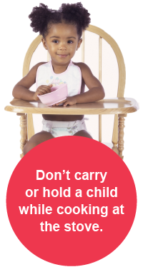
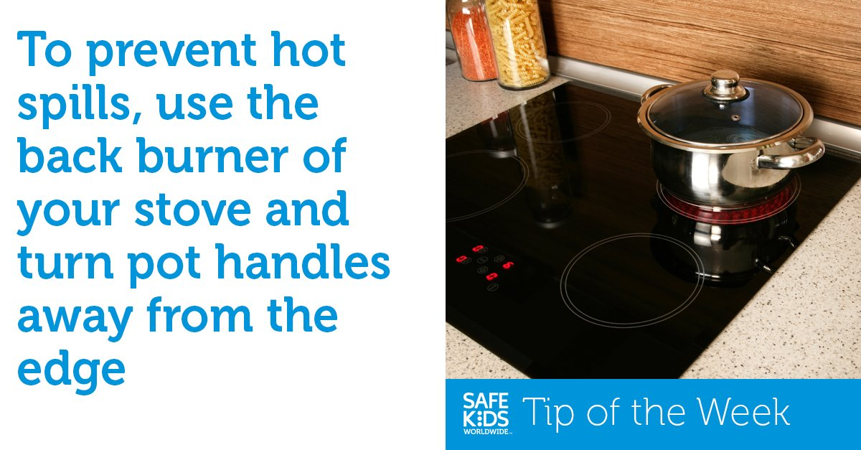
Kitchen Burns: Prevention
According to the American Academy of Pediatrics, most children admitted to burn units are burned by food or something involving the preparation and consumption of food
Sources:
https://www.mayoclinic.org/healthy-lifestyle/infant-and-toddler-health/in-depth/child-safety/art-20044027
https://www.nationwidechildrens.org/family-resources-education/health-wellness-and-safety-resources/helping-hands/burn-prevention-infant-and-toddler
https://www.healthychildren.org/English/safety-prevention/at-home/Pages/Microwave-Safety.aspx
Notes:
Prevention Practices:
-Do not hold a baby while eating, drinking, or preparing hot foods; instead, place your baby in a highchair at least 3-feet from where you are cooking
-Keep hot foods away from children until cooled to proper eating temperature; stir well and let stand for at least 2 minutes
-Keep coffeepots and cups away from the edge of tables and counters
-Avoid tablecloths that hang too low and placemats that can be pulled down
-Create a kid-free zone at least 3-feet away from cooking space
-Turn the handles of pots and pans toward the back while cooking on the stove
-Use back burners whenever possible while cooking on the stove
-Keep electrical cords to appliances from dangling over counter edges
Notes of Importance About Microwaves, according to the AAP:
-Children as young as 17 months can operate a microwave, including starting, opening, and removing contents
-Even if your microwave is high, children can climb on counters to access it
-Always follow manufacturer’s instructions for recommended operation procedures and safety precautions
-Always provide supervision of your children when cooking food in the microwave
-If your child is too young to follow written directions, s/he is too young to use the microwave without supervision
-Remember that food and liquids heat unevenly in the microwave, so it is important to check the temperature before serving
-Never warm your baby’s bottle in the microwave
Information taken from:
https://www.mayoclinic.org/healthy-lifestyle/infant-and-toddler-health/in-depth/child-safety/art-20044027
https://www.nationwidechildrens.org/family-resources-education/health-wellness-and-safety-resources/helping-hands/burn-prevention-infant-and-toddler
https://www.healthychildren.org/English/safety-prevention/at-home/Pages/Microwave-Safety.aspx
Photos credited to:
https://www.safekids.org/safetytips/field_risks/burns-and-scalds
https://twitter.com/safekids/status/960890828137758720
https://twitter.com/shrinershosp/status/1092932130613514240

Slide 10
Sunburn: Prevention
Keep children out of direct midday sun (10 am to 2 pm) as much as possible
Apply sunscreen with SPF 30 at least 30 minutes before your child is out in the sun
Dress your child in a brimmed hat when out in the sun
Sunburns can occur even in cloudy days
Source: https://www.nationwidechildrens.org/family-resources-education/health-wellness-and-safety-resources/helping-hands/burn-prevention-infant-and-toddler
Notes:
Information taken from:
https://www.nationwidechildrens.org/family-resources-education/health-wellness-and-safety-resources/helping-hands/burn-prevention-infant-and-toddler
Photo taken from:
https://scienceblog.cancerresearchuk.org/2014/07/01/will-i-burn-our-new-online-app-helps-you-predict-todays-sunburn-risk/

Slide 11
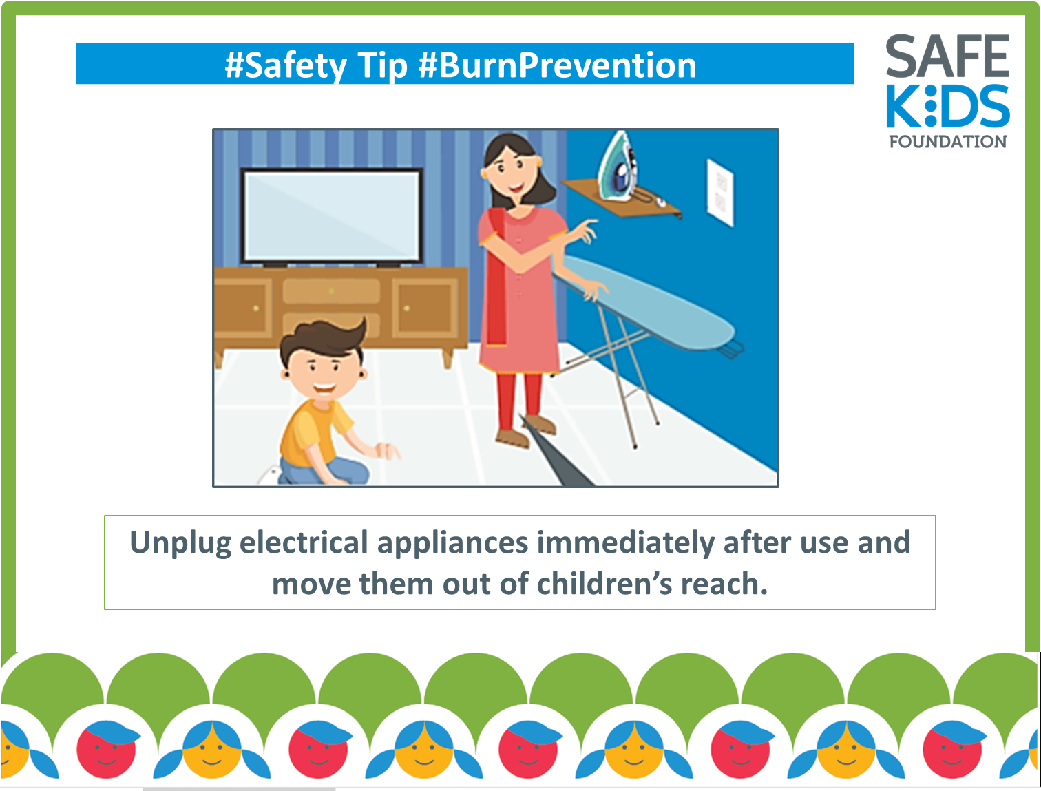
Touching or Falling on Hot Appliances: Prevention
Always supervise children near hot appliances such as clothes irons, curling irons, space heaters, oven doors, fireplaces, and lights
Store hot appliances unplugged and out of reach
Sources:
https://www.mayoclinic.org/healthy-lifestyle/infant-and-toddler-health/in-depth/child-safety/art-20044027
https://www.nationwidechildrens.org/family-resources-education/health-wellness-and-safety-resources/helping-hands/burn-prevention-infant-and-toddler
Notes:
Information taken from:
https://www.mayoclinic.org/healthy-lifestyle/infant-and-toddler-health/in-depth/child-safety/art-20044027
https://www.nationwidechildrens.org/family-resources-education/health-wellness-and-safety-resources/helping-hands/burn-prevention-infant-and-toddler
Photo taken from:
https://www.facebook.com/SafeKidsIndia/photos/a.495919690487187/2970924672986664/?type=3&theater

Slide 12
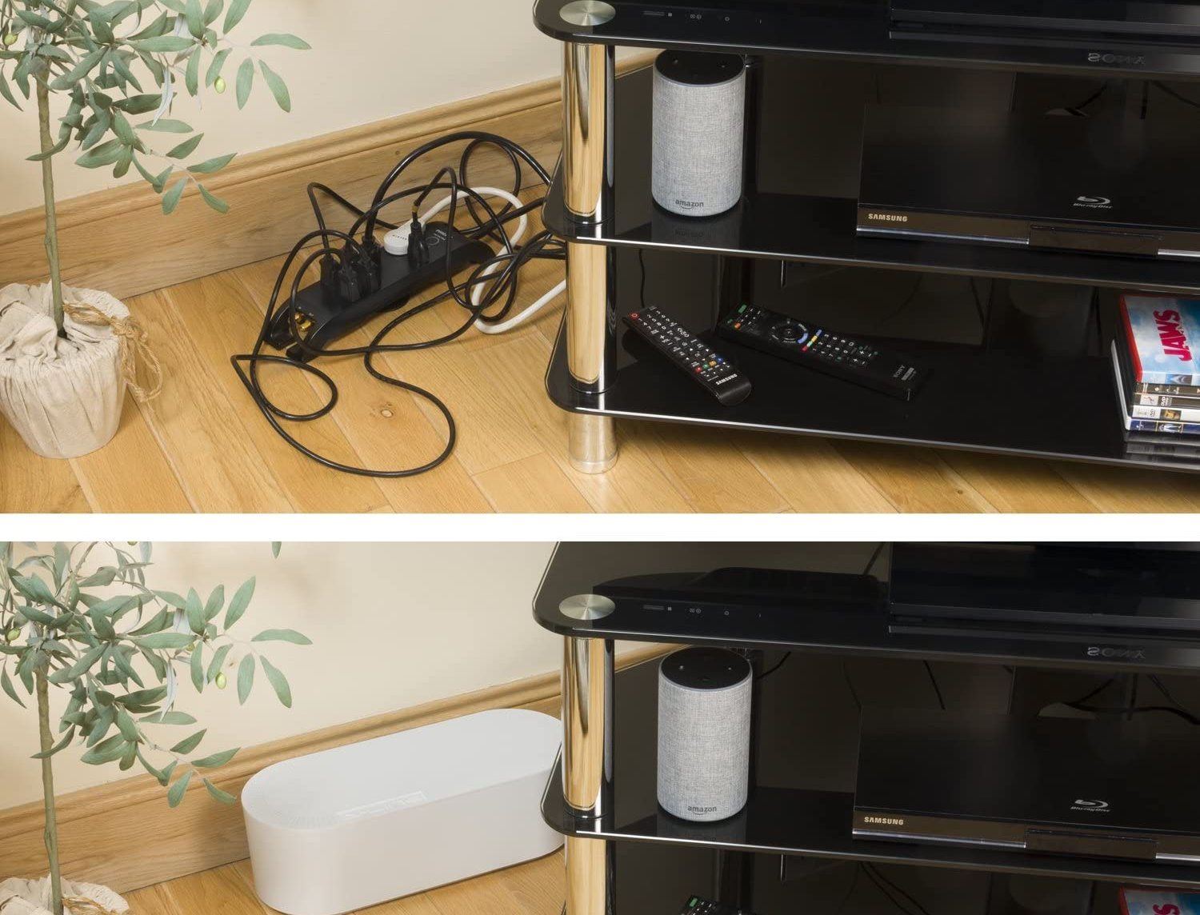
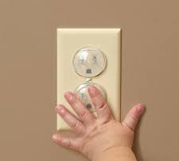
Electrical Cords & Outlets: Prevention
Children can suffer serious burn injuries from biting or chewing on electrical cords and sticking fingers or metal objects into electrical outlets
Keep cords and wires out of sight (e.g., behind furniture) so children cannot pull or chew on them
If cords of frayed, broken, or worn, replace them immediately
Cover unused electrical outlets with safety outlet covers
Sources:
https://www.mayoclinic.org/healthy-lifestyle/infant-and-toddler-health/in-depth/child-safety/art-20044027
https://www.nationwidechildrens.org/family-resources-education/health-wellness-and-safety-resources/helping-hands/burn-prevention-infant-and-toddler
Notes:
Information taken from:
https://www.mayoclinic.org/healthy-lifestyle/infant-and-toddler-health/in-depth/child-safety/art-20044027
https://www.nationwidechildrens.org/family-resources-education/health-wellness-and-safety-resources/helping-hands/burn-prevention-infant-and-toddler
Image taken from:
https://www.babysafehomes.com/baby-proofing-electrical-outlets-for-your-child/
https://www.amazon.com/D-Line-Management-Electrical-Computers-Electrically/dp/B00B1EO1RM/ref=sr_1_15?dchild=1&keywords=electrical+cord+baby+proof&qid=1601055039&sr=8-15

Slide 13
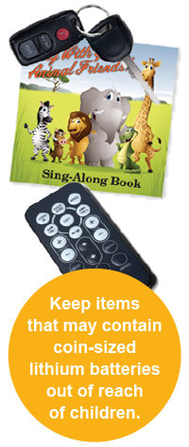
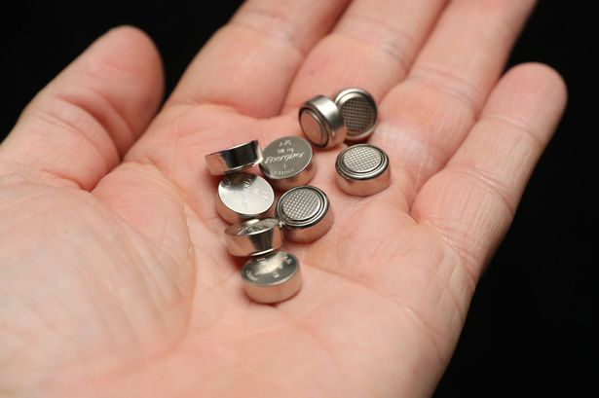
Eating or Drinking Chemicals & Button Batteries: Prevention
Keep coin lithium battery-controlled devices out of sight and reach of children
Loose batteries should be stored out of sight
Place duct tape over the battery compartments to prevent children from accessing batteries
Keep all chemicals locked away
If you suspect your child has ingested a battery (including placing in the nose or ear), go to the hospital immediately
Do not induce vomiting
Do not allow your child to eat or drink anything
Swallowed batteries burn through a child’s esophagus in just 2 hours
National Battery Ingestion Hotline: 1-800-498-8666 | Poison Control: 1-800-222-1222
Sources:
https://www.safekids.org/safetytips/field_risks/batteries
https://www.poison.org/articles/button-batteries
Notes:
Facts about button batteries:
-Each year in the US, over 2,800 kids are treated in emergency rooms after swallowing button batteries, equivalent of one child every three hours
-The number of serious injuries or deaths as a result of swallowed button batteries have increased by nine-fold over the past 10 years
-Swallowed batteries burn through a child’s esophagus in just 2 hours, which will require surgery, months with feeding and breathing tubes, or death
-20mm, 3-volt lithium coin cells are most dangerous because they can become stuck in the esophagus and burn faster
-These small batteries are likely coded as CR2032, CR2025, or CR2016, which will be engraved on the battery
-Items that contain button batteries include remote controls, singing greeting cards, digital scales, watches, hearing aids, thermometers, children’s toys, calculators, key fobs, t-light candles, and flashing holiday jewelry or decorations
-A list of additional items that contain button batteries can be found at https://www.poison.org/articles/button-batteries
*Share this information with caregivers, friends, family members, and babysitters*
Information taken from:
https://www.safekids.org/safetytips/field_risks/batteries
https://www.poison.org/articles/button-batteries
Photos taken from:
https://www.safekids.org/safetytips/field_risks/batteries
https://www.gloucestershirelive.co.uk/whats-on/family-kids/warning-parents-dangers-button-batteries-3024866

Slide 14
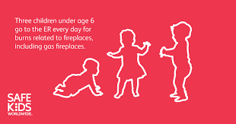
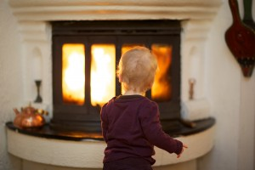
Flames & Sparks: Prevention
Keep lighters and matches out of reach
Always extinguish cigarettes or candles before leaving a room and keep out of children’s reach
Keep children away from fireplaces, BBQ grills, kerosene heaters, woodburning stoves, campfires, and firepits
Use protective screens and doors for fireplaces
Sources:
https://www.mayoclinic.org/healthy-lifestyle/infant-and-toddler-health/in-depth/child-safety/art-20044027
https://www.nationwidechildrens.org/family-resources-education/health-wellness-and-safety-resources/helping-hands/burn-prevention-infant-and-toddler
Notes:
Additional Prevention Practices:
-Don’t allow children to play with or near fireworks
-Never smoke while holding your child
-Discard smoking materials in deep or wet receptacles
-Be aware that glass on gas fireplaces can take over an hour to cool down after it has been turned off
Information taken from:
https://www.mayoclinic.org/healthy-lifestyle/infant-and-toddler-health/in-depth/child-safety/art-20044027
https://www.nationwidechildrens.org/family-resources-education/health-wellness-and-safety-resources/helping-hands/burn-prevention-infant-and-toddler
Photos taken from:
https://www.safekids.org/infographic/fireplace-safety-infographic
https://safekidsgeorgia.org/2014/02/06/keep-your-family-safe-from-fire/

Slide 15
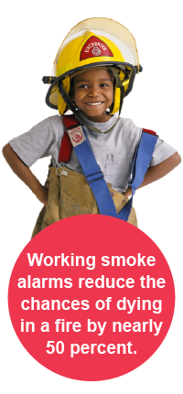
Fire Safety: Prevention
Install smoke alarms
Keep fire extinguishers in the kitchen and garage
Have an evacuation plan in place
Regularly clean appliances such as grills and fireplaces
Sources:
https://www.mayoclinic.org/healthy-lifestyle/infant-and-toddler-health/in-depth/child-safety/art-20044027
https://www.stanfordchildrens.org/en/topic/default?id=preventing-burn-injuries-90-P01750
Notes:
Install smoke alarms
-At least one on each level of the home, inside and outside of all sleeping areas
-Clean and test monthly to ensure they’re working
-Use lifelong batteries or change at least once a year
-Replace if alarms are over 10 years old
-Don’t smoke cigarettes inside the house, especially in bed
Evacuation Plan
-Practice every six months
-Determine two ways to exit each room and where to meet outside
-Don’t use lockable doorknobs on children’s bedroom
-Teach children to leave a smoky area by crawling on the floor
-Teach children to stop, drop, and roll
Clean Appliances
-Fireplaces should be cleaned annually
Information taken from:
https://www.mayoclinic.org/healthy-lifestyle/infant-and-toddler-health/in-depth/child-safety/art-20044027
https://www.stanfordchildrens.org/en/topic/default?id=preventing-burn-injuries-90-P01750
Photo taken from:
https://www.safekids.org/fire

Slide 16
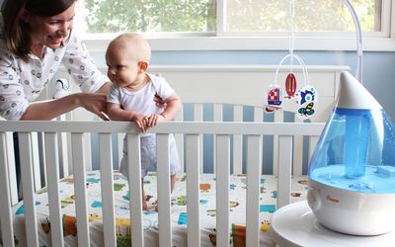
Burn Prevention: Additional Safety Precautions
Car Seats
Use a cloth or towel to cover car seat when not in use to prevent buckles and straps from getting too hot
Vaporizers
Only use cold vaporizers
Space heaters
Keep at least 3 feet away from bedding, drapes, furniture, and other flammable materials
Pavement
Encourage children to wear shoes in the summer and avoid hot asphalt
Sources:
https://www.mayoclinic.org/healthy-lifestyle/infant-and-toddler-health/in-depth/child-safety/art-20044027
https://www.nationwidechildrens.org/family-resources-education/health-wellness-and-safety-resources/helping-hands/burn-prevention-infant-and-toddler
https://www.stanfordchildrens.org/en/topic/default?id=burns-caused-by-heat-90-P01742
Notes:
Information taken from:
https://www.mayoclinic.org/healthy-lifestyle/infant-and-toddler-health/in-depth/child-safety/art-20044027
https://www.nationwidechildrens.org/family-resources-education/health-wellness-and-safety-resources/helping-hands/burn-prevention-infant-and-toddler
https://www.stanfordchildrens.org/en/topic/default?id=burns-caused-by-heat-90-P01742
Photo taken from:
https://www.verywellfamily.com/before-you-buy-humidifiers-and-vaporizers-2632311
https://health.clevelandclinic.org/5-myths-about-hot-car-dangers-debunked/

Slide 17
Prevention Practices “In a Flash with A Splash”
Source: http://flashsplash.org/
Notes:
Link to video:
http://flashsplash.org/

Slide 18
Immediate Responses: What to do if Your Child is Burned
Take the follow steps when your child is burned:
Remove all clothing, diapers, jewelry, and metal from the burned area (these can hide underlying burns and retain heat which can cause greater skin damage)
Put burn under cool (not cold) water to stop burning process for approximately 3-5 minutes
Do NOT apply creams, ointments, sprays, or other home remedies
Do not rub the burn
Do not use ice as it could cause more damage
Cover burn with a clean, dry cloth; do the same if the burn is oozing and seek immediate medical attention
If the burn is blistered, do not break it
If your child’s clothing is stuck to the burned area, do not attempt to remove it; instead, cut around it and leave the wound intact
Sources:
https://www.usfa.fema.gov/prevention/outreach/burn_prevention.html
http://ameriburn.org/
https://www.stanfordchildrens.org/en/topic/default?id=burns-caused-by-heat-90-P01742
Notes:
Note: The above graphic is a gif and will play in slideshow mode
Immediate Responses:
-Remove all clothing, diapers, jewelry, and metal from the burned area (these can hide underlying burns and retain heat which can cause greater skin damage)
-Put burn under cool (not cold) water to stop burning process for approximately 3-5 minutes
-Do NOT apply creams, ointments, sprays, or other home remedies
-Do not rub the burn
-Do not use ice as it could cause more damage
-Cover burn with a clean, dry cloth; do the same if the burn is oozing and seek immediate medical attention
-If the burn is blistered, do not break it
-If your child’s clothing is stuck to the burned area, do not attempt to remove it; instead, cut around it and leave the wound intact
Information taken from:
https://www.usfa.fema.gov/prevention/outreach/burn_prevention.html
http://ameriburn.org/
https://www.stanfordchildrens.org/en/topic/default?id=burns-caused-by-heat-90-P01742

Slide 19
Time to Take Action
Signs of Serious Injury that Require Medical Attention:
Child not eating or drinking
Is antisocial or exhibiting disruptive behavior
Signs of infection (healing burn areas change and become red, warm, swollen, extremely tender, or have a foul odor)
Uncontrollable itching
Scar cracks open or splits
Tissues around joint tighten and the joint loses mobility
If burn in on an arm or leg and the child has trouble moving that limb and three affected fingers or toes
Excessive swelling in injured area
Temp greater than 101.5º F
Dressing changes are painful
Source: https://www.stanfordchildrens.org/en/topic/default?id=after-a-burn-when-to-call-your-childs-healthcare-provider-90-P01751
Notes:
Symptoms that require medical attention:
-Child not eating or drinking
-Is antisocial or exhibiting disruptive behavior
-Signs of infection (healing burn areas change and become red, warm, swollen, extremely tender, or have a foul odor)
-Uncontrollable itching
-Scar cracks open or splits
-Tissues around joint tighten and the joint loses mobility
-If burn in on an arm or leg and the child has trouble moving that limb and three affected fingers or toes
-Excessive swelling in injured area
-Temp greater than 101.5º F
-Dressing changes are painful
Information taken from:
https://www.stanfordchildrens.org/en/topic/default?id=after-a-burn-when-to-call-your-childs-healthcare-provider-90-P01751

Slide 20
Burn Prevention: Summary
“Liquid and steam burn like fire” and can cause serious injuries, with young children being particularly at risk
You can prevent your child from being seriously injured from burns by following the prevention guidance provided in this presentation
Supervise children around and apply proper safety measures to common burn areas
Set bath water to a safe bathing temperature
In the kitchen, establish a kid-free zone at least 3-feet from cooking space, use backburners, and turn pot handles away from the edge
Apply sunscreen at least 30 minutes before going out into the sun
Provide supervision around hot appliances and store these items unplugged and out of reach
Baby proof electrical cords and outlets with wire storage boxes and outlet covers
Keep all batteries and chemical locked away, and secure battery compartments with duct tape
Provide supervision around fireplaces, grills, and other equipment with open flames
Install smoke alarms, have an evacuation plan, and clean appliances regularly to prevent fires in the home

Slide 21
Burn Prevention: Local Resources & Contact Information
Community resources near you:
[Include county-specific and local resources here]
Thank you!

Slide 22
Burn Prevention Additional Information
American Burn Association Prevention Resources
American Burn Association Burn Prevention Helpful Tips Infographic
CDC Child Injury Infographic
National Scald Prevention Campaign: In a Flash with a Splash
National Scald Prevention Campaign Infographics
National Scald Prevention Campaign Toolkit
Nationwide Children's Burn Prevention: Infant and Toddler
Safe Kids Worldwide Cooking Safety Checklist
Safe Kids Worldwide Burn and Scald Prevention Tips
Safe Kids Worldwide Button Battery Tip Card
Safe Kids Worldwide Burn Prevention for Families with Children with Special Needs
Stanford Children's Health Burns Quiz
U.S. Fire Administration Burn and Scald Prevention
U.S. Fire Administration Summertime Burn Safety
U.S. National Library of Medicine Burn Injury Information

Slide 23
Photo Attributions
Image of boy with blocks spelling “safe”: https://www.kidcheck.com/blog/kidcheck-shares-safety-tips-vbs/
Infographic with 3rd degree burn info: https://twitter.com/safekids/status/1190274679002533888
Image of boy in bathtub with mother supervising: http://www.findglocal.com/US/Southfield/1965871263724831/Safe-Kids-Oakland-County
Image of girl in highchair: https://www.safekids.org/safetytips/field_risks/burns-and-scalds
Image of a pot on a stove: https://twitter.com/safekids/status/960890828137758720
Image of boy reaching for coffee mug: https://twitter.com/shrinershosp/status/1092932130613514240
Image of mother and two babies at the beach: https://scienceblog.cancerresearchuk.org/2014/07/01/will-i-burn-our-new-online-app-helps-you-predict-todays-sunburn-risk/
Graphic of mother and son with electrical appliance tips: https://www.facebook.com/SafeKidsIndia/photos/a.495919690487187/2970924672986664/?type=3&theater
Image of electrical cord baby proofing box: https://www.amazon.com/D-Line-Management-Electrical-Computers-Electrically/dp/B00B1EO1RM/ref=sr_1_15?dchild=1&keywords=electrical+cord+baby+proof&qid=1601055039&sr=8-15
Image of safety outlet covers with child’s hand: https://www.babysafehomes.com/baby-proofing-electrical-outlets-for-your-child/
Graphic of key fob, remote, and sing-along book: https://www.safekids.org/safetytips/field_risks/batteries
Image of button batteries held in the palm of the hand: https://www.gloucestershirelive.co.uk/whats-on/family-kids/warning-parents-dangers-button-batteries-3024866
Graphic of silhouettes of three children: https://www.safekids.org/infographic/fireplace-safety-infographic
Image of child facing a lit fireplace: https://safekidsgeorgia.org/2014/02/06/keep-your-family-safe-from-fire/
Image of boy in firefighter uniform: https://www.safekids.org/fire
Image of father putting baby in a car seat: https://health.clevelandclinic.org/5-myths-about-hot-car-dangers-debunked/
Image of mother and baby in nursery next to vaporizer: https://www.verywellfamily.com/before-you-buy-humidifiers-and-vaporizers-2632311
Burn treatment gif: https://www.usfa.fema.gov/prevention/outreach/burn_prevention.html

